Slide 1
Using Bayesian Optimization in Pose Graphs Based SLAM 15th August
Zuxun Wang

Slide 2
Simulator Outputs and Data Diversity
As part of our investigation, we are considering the application of multiple subgraphs.
Each with its own prediction interval length, somewhat mirroring the concept of running separate Kalman filters.
Point of concern: Data sets used to run all the subgraphs.
Whether all our subgraphs are based on the same output from the simulator?

Slide 3
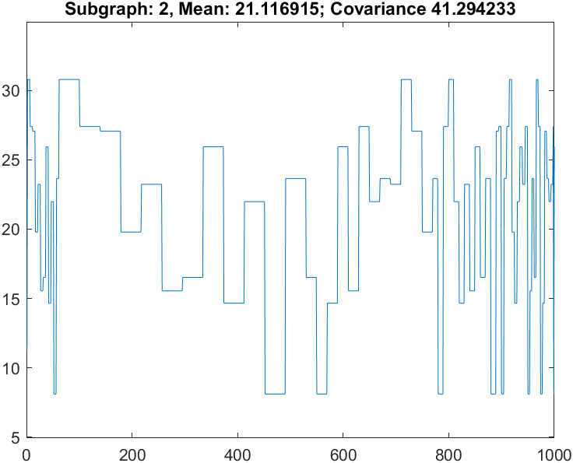
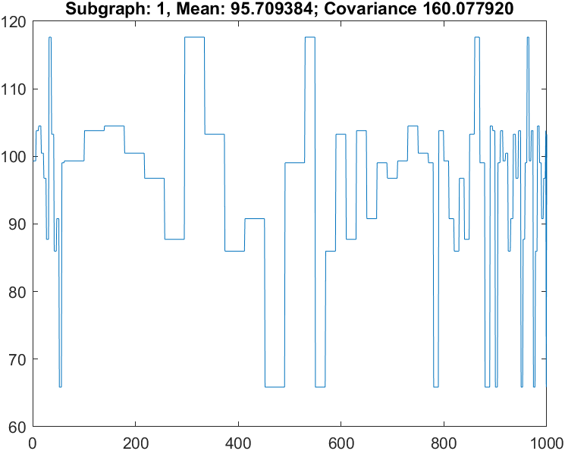
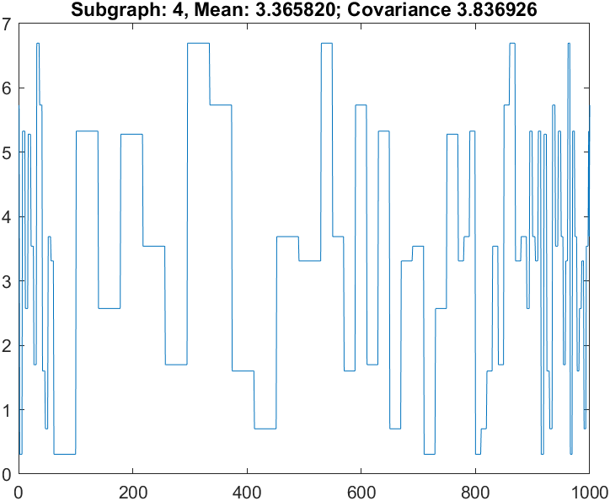
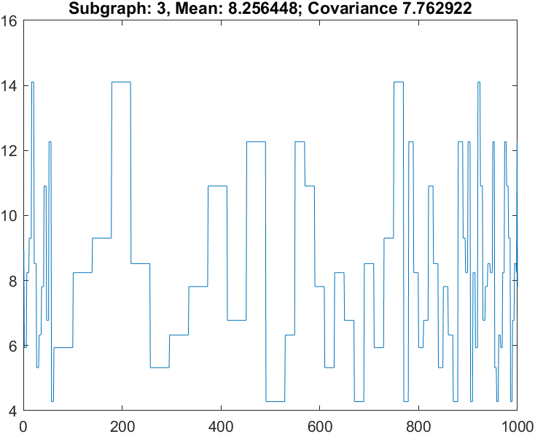
Linear System with Stored Simulated Results (Enable Prop4)
Total number of timestep: 200
Number of episodes: 1000
Num of subgraph: 4
numObs: 50
obsPeriod: [1 5 10 15]
Result CNIS Values for each subgraph using optimal Omega values:
[0.184866515243119,
0.296906556890462,
0.754782867731276,
0.907392823044182]

Slide 4
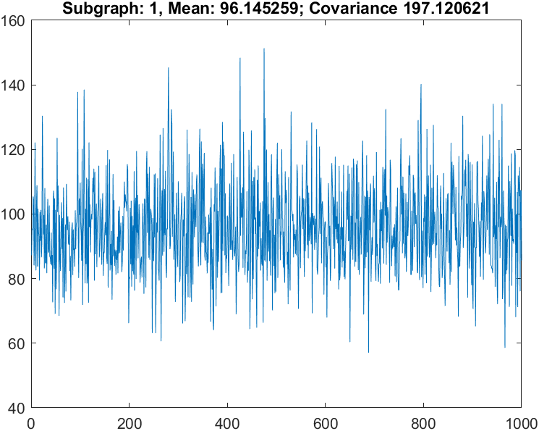
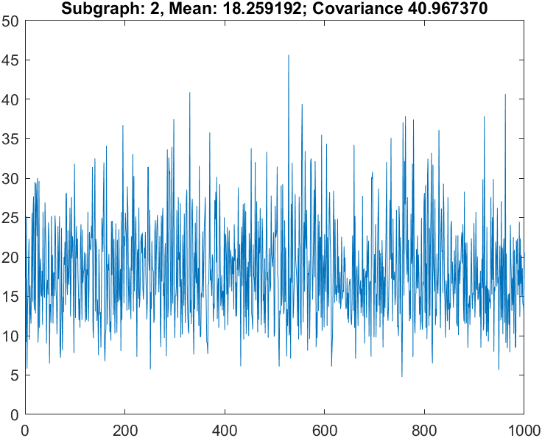
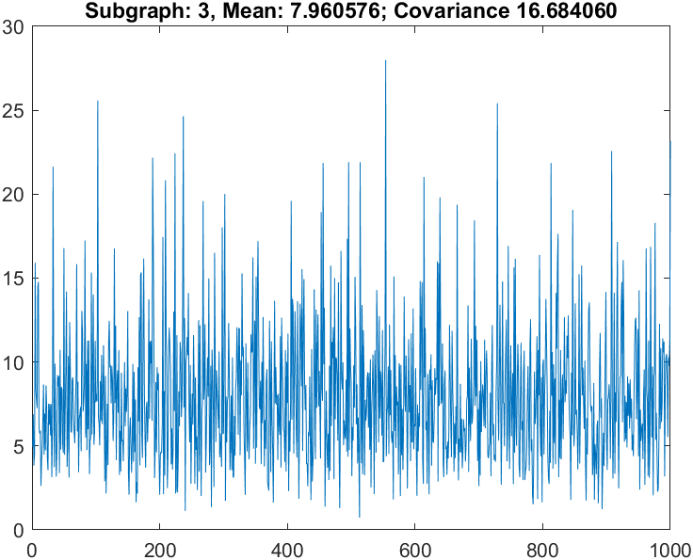
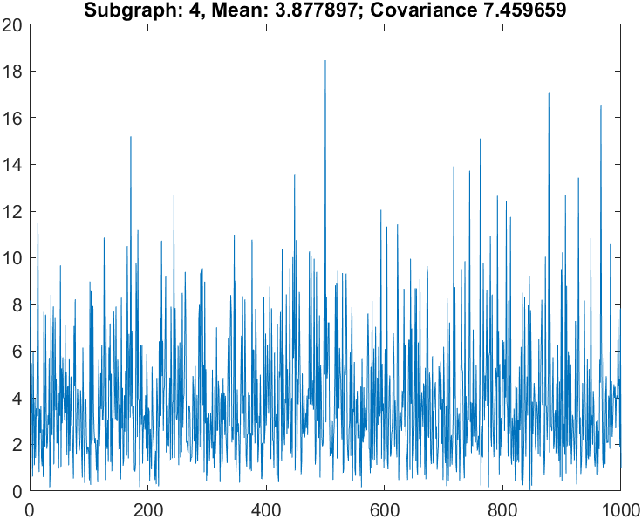
Linear System with Diff Simulated Results (Enable Prop4)
Total number of timestep: 200
Number of episodes: 1000
Num of subgraph: 4
numObs: 50
obsPeriod: [1 5 10 15]
Result CNIS Values for each subgraph using optimal Omega values:
[0.027832434017780,
0.143553835019665,
0.046805200597442,
0.100933193696296]

Slide 5
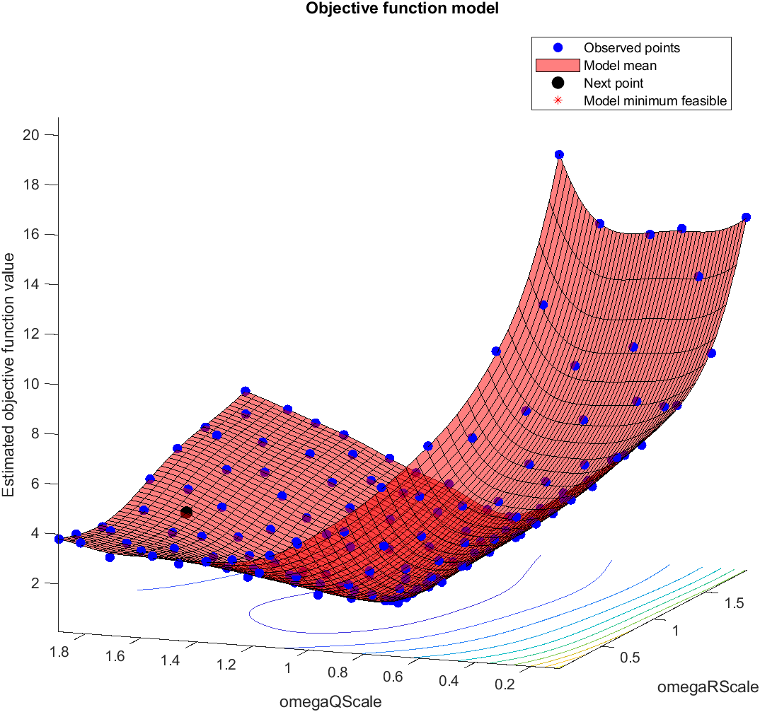
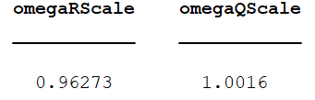
Linear BayesOpt Results (Scenario 1.1 - Prop4)
In this scenario, we use different simulated results.
And, for each subgraph, we lay down vertices at the same interval.
Total number of timestep: 200
Number of episodes: 1000
numObs: 50
obsPeriod: [1 5 10]
Cost Function: sum(C), where C stores CNIS value for each subgraph

Slide 6
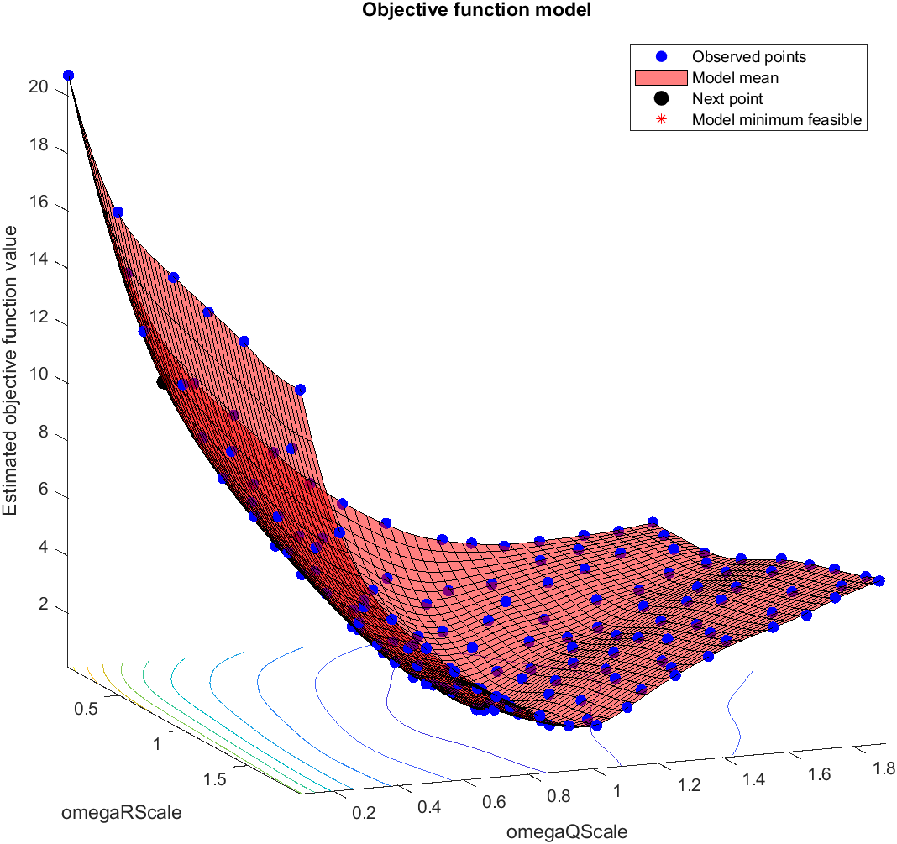
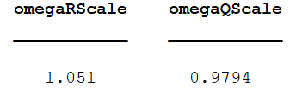
Linear BayesOpt Results (Scenario 1.2 - Prop4)
In this scenario, we use different simulated results.
And, for each subgraph, we lay down vertices only when observations are taken.
Total number of timestep: 200
Number of episodes: 1000
numObs: 50
obsPeriod: [1 5 10]
Cost Function: sum(C), where C stores CNIS value for each subgraph

Slide 7
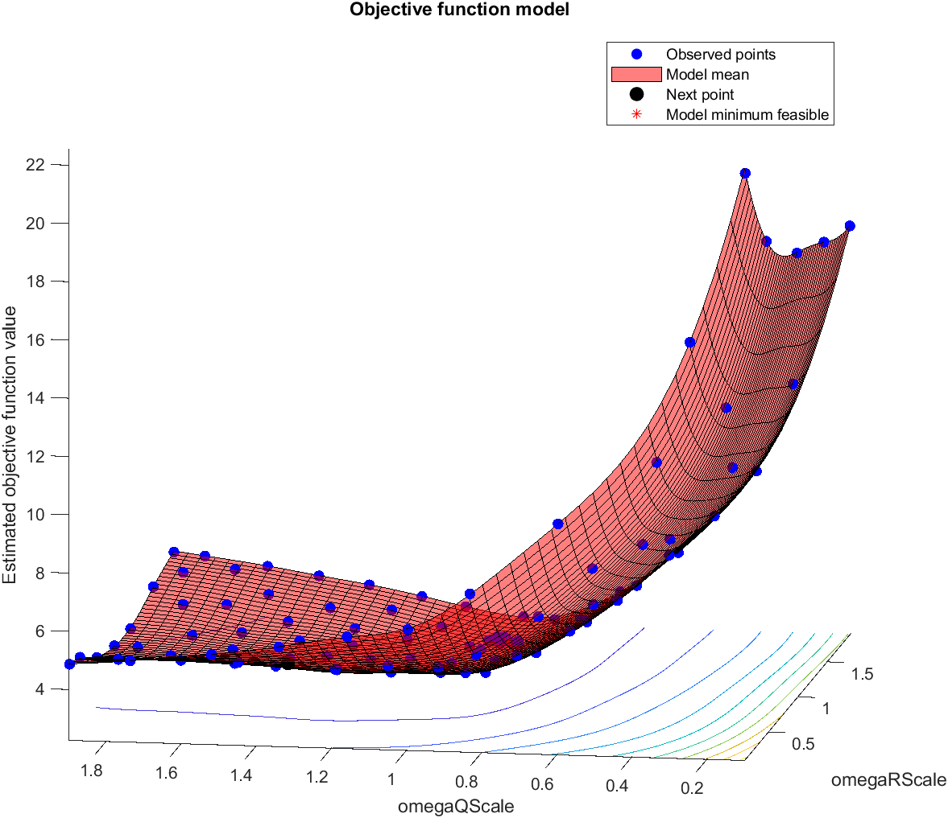
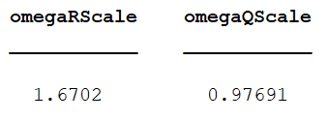
Linear BayesOpt Results (Scenario 1.1 - Prop4)
In this scenario, we use stored simulated results.
And, for each subgraph, we lay down vertices at the same interval.
Total number of timestep: 200
Number of episodes: 1000
numObs: 50
obsPeriod: [1 5 10]
Cost Function: sum(C), where C stores CNIS value for each subgraph

Slide 8
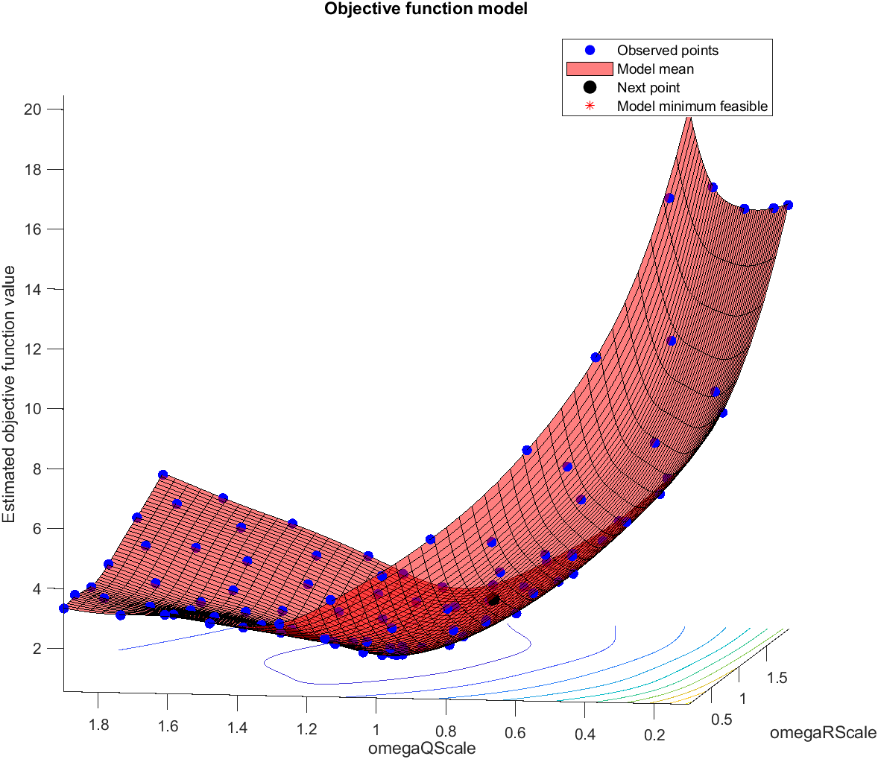
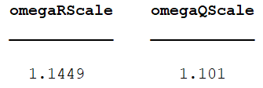
Linear BayesOpt Results (Scenario 1.2 - Prop4)
In this scenario, we use stored simulated results.
And, for each subgraph, we lay down vertices only when observations are taken.
Total number of timestep: 200
Number of episodes: 1000
numObs: 50
obsPeriod: [1 5 10]
Cost Function: sum(C), where C stores CNIS value for each subgraph

Slide 9
Brute Force Optimal Omega Values
Scenario 1.1 - Different Simulation
OmegaQScale: 1, OmegaRScale: 1, gives the minimum value
------------------------------------------------------------
Scenario 1.2 – Different Simulation
OmegaQScale: 1, OmegaRScale: 1, gives the minimum value
------------------------------------------------------------
Scenario 1.1 – Simulation Stored
OmegaQScale: 9.500000e-01, OmegaRScale: 1.150000e+00, gives the minimum value
------------------------------------------------------------
Scenario 1.2 – Simulation Stored
OmegaQScale: 9.000000e-01, OmegaRScale: 1.200000e+00, gives the minimum value
------------------------------------------------------------

Slide 10
Summary
Compared with the case where we have different simulated results, using the same simulation data will lead to inaccurate results.
Either way vertices are laid down can give the expected omega values.

Slide 11
Notes from Meeting
Zhaozhong agrees with the idea that we should use different simulator results for each running episode.
He thinks the graphs that generated by BayesOpt using different simulation results are pretty good.
He also offer me a suggestion that I could generate the ground truth plots for CNIS values and compare with the BayesOpt results, especially for those which gives bad results. (e.g., can’t find the global minimum)
If the GT graph does have a global minimum, then we should apply some tricks to make BO can observe it. (e.g., apply some scale to the cost function)
(Plotting the GT IS NOT the manual tuning method!!! So, I need to rethink about the corresponding report part when writing it.)
As for the high dimension examples, Zhaozhong does not know if those examples can fit the factor graph problem well. He recommends me to focus more on our existing examples as I don’t have too much time left for this project.

